Slide 1

Teamwork makes the dreamwork (PhD version)

Slide 2
Agenda
Who are we?
Establish Norms
This I believe
Involvement
Research Outline
Closing

Slide 3

Who are we?
Why do you do the work that you do?

Slide 4
Establishing Norms
I am not here to be right, I am here to get it right
Sense of belonging
Open communication is key
Support, challenge, counter
Leaving room for constructive silence
Listen to understand, speak with authenticity
Celebrate accomplishments
Maintain confidentiality
End on time

Slide 5
Establishing Norms
Thinking of other committees, you have been on, what are other good norms to establish early on?

Slide 6
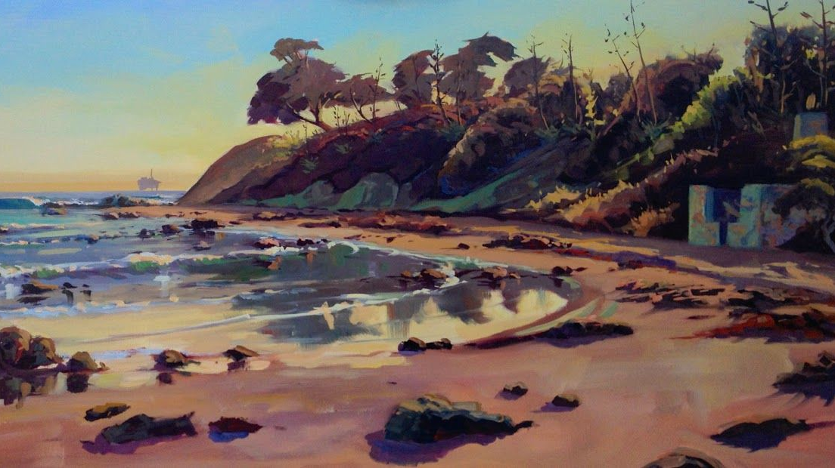
This I believe

Slide 7
Involvements
MARC
Trainee development
Research
EAGER Project
SACNAS
SURF support
VOICES
Planning Committee
Applications
Course development
Active participant
Est. chapter

Slide 8
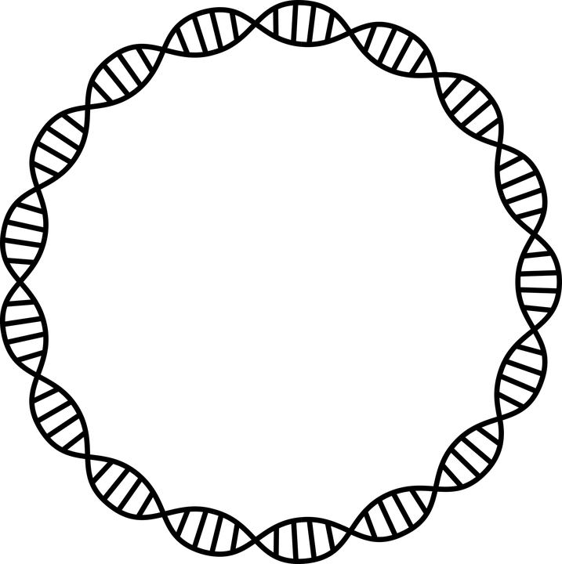

Research Outline
EAGER Project
EecSeq
Project Objectives
Outcomes
Research directions
Disease and environment
Multi-species study

Slide 9

EAGER EecSeq Project

Slide 10
Exome Capture Sequencing (EecSeq)
Cost-effective and custom design
De novo “mechanism”
Genes/Alleles/Loci under selection
Genome = DNA
Exon
Intron
Exon
Exon
Transcription
Transcriptome = RNA
Notes:
Exome = Exons

Slide 11
Exome Capture Sequencing (EecSeq)
Exome = exons
Make proteins & do work
Reduced Representation Sequencing
Genome = DNA
Exon
Intron
Exon
Exon
Exome = Exons
Notes:
Exome = Exons

Slide 12
EecSeq: What I have & What I want
DNA (Gene)
B
B
B
cDNA synthesis
B
mRNA
Probe
Puritz JB, Lotterhos KE. 2018. Mol Ecol Resour. Nov;18(6):1209-1222. doi: 10.1111/1755-0998.12905.
Notes:
Exome = Exons

Slide 13
EecSeq: What I have & What I want
Hybridization
Exome Reads
Puritz JB, Lotterhos KE. 2018. Mol Ecol Resour. Nov;18(6):1209-1222. doi: 10.1111/1755-0998.12905.
Notes:
Exome = Exons

Slide 14
EAGER Project Objectives
Intent: Development of a tool to rapidly and cost-effectively sequence the exome of any organism
How?:
Optimization of molecular methods
Validation of EecSeq data quality vs other
Bioinformatic development

Slide 16
Workflow Phase 1: Molecular Optimization
Obj.A
Obj.B
Determine the optimal level of probe and capture pool diversity
Create replicate capture pools 4, 6, 8, 12 individuals
Obj.C
Optimize the ratio of probes to genomic library for efficient hybridization and capture
100, 250, and 500 ng probes and gDNA library
Cross with all combinations except 4 most extreme
Factorial cross combination
Quantify the role of probe and insert length in exome capture efficiency and specificity
180, 350 bp DNA insert and 180, 270, and 360 cDNA probe length
Factorial cross combination

Slide 17
Workflow Phase 2
Validation
WGS
RNAseq
MYbaits

Slide 18
Problem
There are no de novo exome assembly methods for exome capture
Let's test de novo transcriptome assembly programs
Notes:
N50: The N50 is defined as the minimum contig length needed to cover 50% of the genome. It means, half of the genome sequence is in contigs larger than or equal the N50 contig size.
BUSCO: Benchmark Universal Single Copy Ortholog. Orthologs are genes in different species that evolved from a common ancestral gene by speciation, and, in general, orthologs retain the same function during the course of evolution.
Annotation: DNA annotation or genome annotation is the process of identifying the locations of genes and all of the coding regions in a genome and determining what those genes do.
Mapping: assigning/locating of a specific gene to region of a chromosome and determining the location of and relative distances between genes on the chromosome.

Slide 19
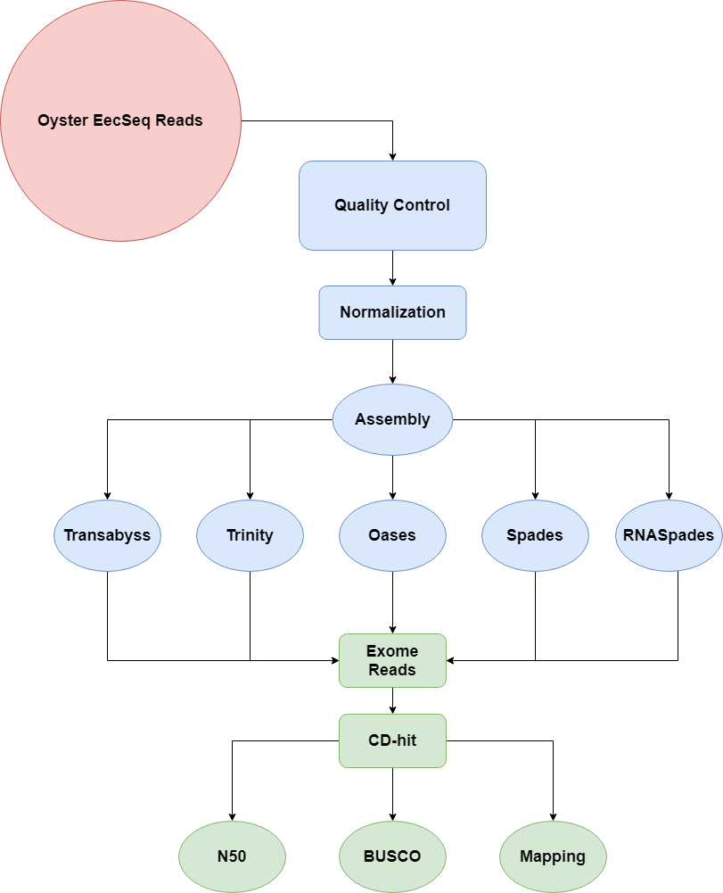
Exome Assembly Workflow Testing 5 de novo transcriptome assembly programs to generate exome assemblies

Slide 20
BUSCO Eukaryota (n =303) High Fragmentation Oases performs best

Slide 21
BUSCO Mollusca (n =5295) Lots of missing orthologs Transabyss performs best

Slide 22
Bioinformatic Outcomes
We can assemble de novo exome assemblies with existing programs but…
Species specific BUSCO results are pushing us to develop a new assembly framework for exome reads
Notes:
N50: The N50 is defined as the minimum contig length needed to cover 50% of the genome. It means, half of the genome sequence is in contigs larger than or equal the N50 contig size.
BUSCO: Benchmark Universal Single Copy Ortholog. Orthologs are genes in different species that evolved from a common ancestral gene by speciation, and, in general, orthologs retain the same function during the course of evolution.
Annotation: DNA annotation or genome annotation is the process of identifying the locations of genes and all of the coding regions in a genome and determining what those genes do.
Mapping: assigning/locating of a specific gene to region of a chromosome and determining the location of and relative distances between genes on the chromosome.

Slide 23
Workflow Phase 3
De novo assembly
Finished initial assemblies
Reassess and redesign
Hybrid Assembly
Sudo reference design
Kmer identification
Validate across datasets
Phase 1 and Phase 2 reads
Pop-level inference

Slide 24







Research Directions
Oyster, Disease, Environment

Slide 25
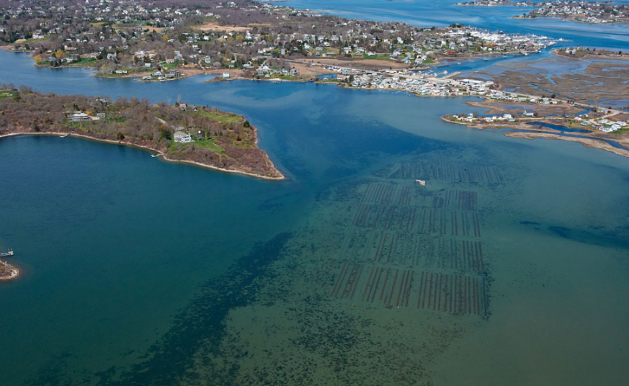
What are the latent and carry over effects of disease and environmental stress on eastern oyster, Crassostrea virginica, larvae as they develop?

Slide 26
Research Hypotheses
Early environmental stress during larval development will shift gene expression of immunological and metabolic molecular networks
Early environmental stress during larval development will compromise immune response to OsHV-1
Multiple environmental stressors during larval development will most severely impact immune response to OsHV-1
OsHV-1 has the ability to restructure the genome through genome to genomnem interactions

Slide 27
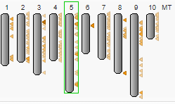
Preliminary BLAST

Slide 28
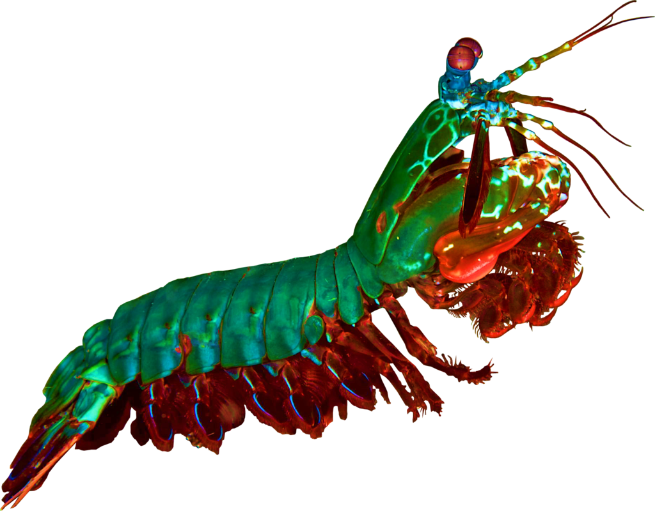
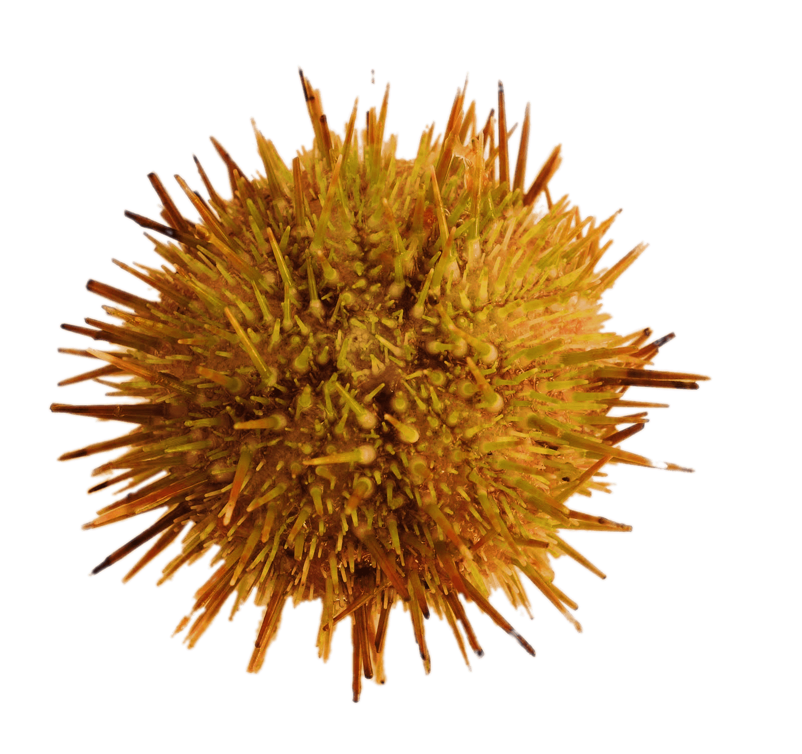
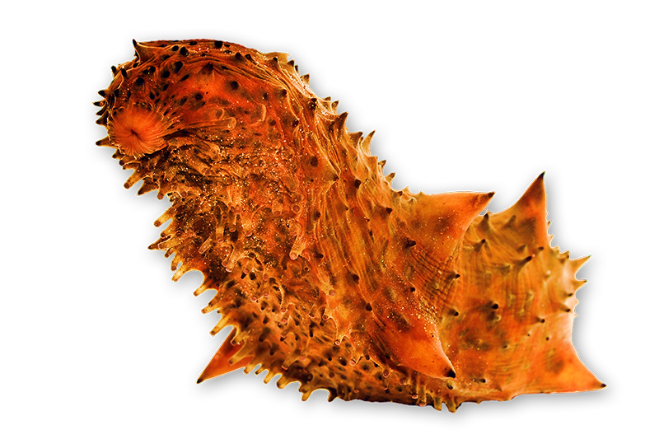
Research Directions
Oyster, Disease, Environment
Non-model invertebrate exploration
Seascape
Phyloexomics
Applied Aquaculture

Slide 29
Degree Timeline
Spring 2021
Obj 1a, Initial Obj3a
Undergrad onboarding
Fall 2021
Obj 1B,1C, Obj 3b
Committee Meeting (1-2), Quals?
Spring 2022
Obj 1C, Obj 3b
Committee Meeting (1-2), Quals?
Undergrad Training
Summer 2021
Obj1B, Obj 3a
Undergrad Training
Summer 2022
Obj 2ab, Obj 3ab
Fall 2022
Committee Meeting (1-2), Comps
Obj 2abc, Obj 3
Expected degree date: Spring 2024

Slide 30
Closing
What did I do well?
What can I do better?
What can I change?

